Slide 1
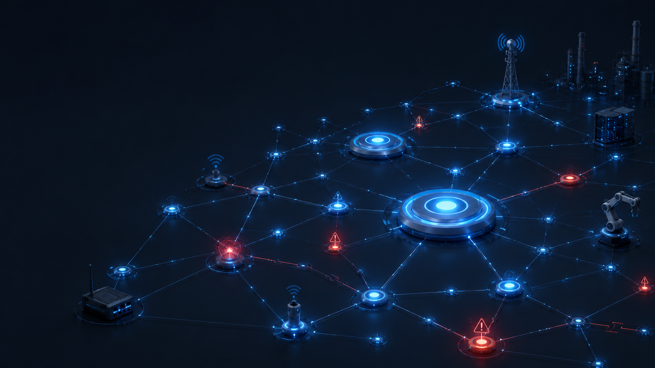
SMART ENVIRONMENTS · PROJECT WORK
Context-Aware IoT
Anomaly Detection
An Ablation Study on Graph Construction
Antonio Pagnotta · Francesco La Piana · Paolo Cencia
Based on Stodt, Reich & Theoleyre. Computer Communications (2026)

Slide 2
CHAPTER 1 · CONTEXT & STATE OF THE ART
The Paper
The Problem
The Gap - No method combines all three:
IoT networks are exposed to heterogeneous, distributed traffic and a broad spectrum of threats.
Attacks come both from outside (scans, malware) and inside (compromised devices).
Traditional detectors ignore context: time, device role, expected behavior.
Valid traffic at the wrong time can itself be the anomaly.
Context-awareness
Graph modeling of device relationships
Real-time capability
Need a framework that models relations, context and dynamic behavior together.
Smart Environments
Context-Aware IoT Anomaly Detection
2

Slide 3
CHAPTER 1 · STODT, REICH & THEOLEYRE (2026)
The Paper's Solution
Combines three ideas into one pipeline
1
2
3
Multi-edge graph
Community detection
GNN detection
Three edge types per device
pair: comm, context,
knowledge.
LPA groups devices into
functional communities,
added as node labels.
A HeteroGNN reconstructs
normal behavior and flags
deviating edges.
Claimed result
AUC ≈ 99% on CIC-ToN-IoT
Smart Environments
Context-Aware IoT Anomaly Detection
3

Slide 4
CHAPTER 2 · THE FRAMEWORK
The Pipeline
Traffic
Capture
Graph
Construction
Community
Detection
Anomaly
Detection
CIC-ToN-IoT, 20% stratified subset
Multi-edge graph per 2h window
LPA labels added to nodes
HeteroGNN classifies each edge
Four sequential stages turn raw network traffic into edge-level anomaly verdicts.
Smart Environments
Context-Aware IoT Anomaly Detection
4

Slide 5
CHAPTER 2 · MULTI-RELATIONAL GRAPH
Graph Construction & Community Detection
Network
Context
Knowledge
Network edges
Context edges
Knowledge edges
Flow duration, packets,
bytes/s, protocol
Inter-arrival times,
active / idle means
Packet/segment sizes,
TCP flag counts
Label Propagation Algorithm (LPA)
Each node repeatedly adopts the most frequent label among its neighbors until labels stabilize.
Limit: very fast and real-time, but non-deterministic so community quality can vary between runs.
Smart Environments
Context-Aware IoT Anomaly Detection
5

Slide 6
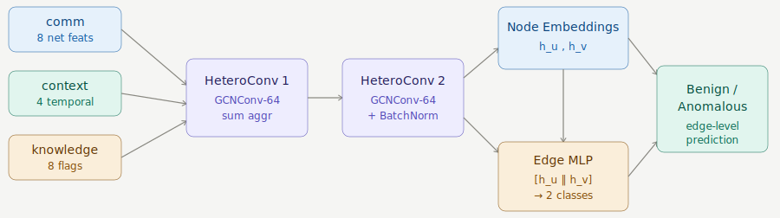
CHAPTER 2 · THE MODEL
HeteroGNN & Edge Classification
Strengths
Costs
Scalable · real-time · context-aware. Separate convolutions per edge type, summed into one node embedding.
Requires labeled data and training is expensive. Edge prediction concatenates the two endpoint embeddings → benign / anomalous.
Smart Environments
Context-Aware IoT Anomaly Detection
6

Slide 7
CHAPTER 3 · OUR ABLATION STUDY
Research Question
How much do the results depend on graph construction?
CONFIG A
CONFIG B
CONFIG C
CONFIG D
network
network + context
network + knowledge
all three
Constant: pipeline · HeteroGNN · dataset · hyperparameters
Variable: only the graph structure (which edge types are built)
Smart Environments
Context-Aware IoT Anomaly Detection
7

Slide 8
CHAPTER 3 · HOW WE RAN IT
Experimental Setup
57
2 h
70 / 30
10
Temporal graphs
(39 train / 18 test)
Time window
per snapshot
Stratified split
train / test
Training epochs
(Apple M2)
Training details
Edge-level classification with focal loss to counter class imbalance; Adam optimizer (lr 1e-3, weight decay 1e-3).
Training graphs filtered to those containing at least one anomaly, so the model sees attack patterns.
Stratified per-graph split, temporal split was infeasible because only 5/39 training graph would contain anomalies (traffic concentrated in last 4-5 days of April). Stratification ensures both train and test sets see attack patterns.
Smart Environments
Context-Aware IoT Anomaly Detection
8

Slide 9
CHAPTER 4 · CIC-TON-IOT
Dataset Overview
5.35 M
85
27 days
≈ 1.07 M
total flows
columns
April 2019
20% subset rows
Key columns
Class balance
Src IP · Dst IP · Timestamp · Label · Attack
Stratified 20% subset keeps the class balance
47% Benign 53% Attack
Roughly balanced and this differs from the paper, which uses a different release of the dataset.
Smart Environments
Context-Aware IoT Anomaly Detection
9

Slide 10
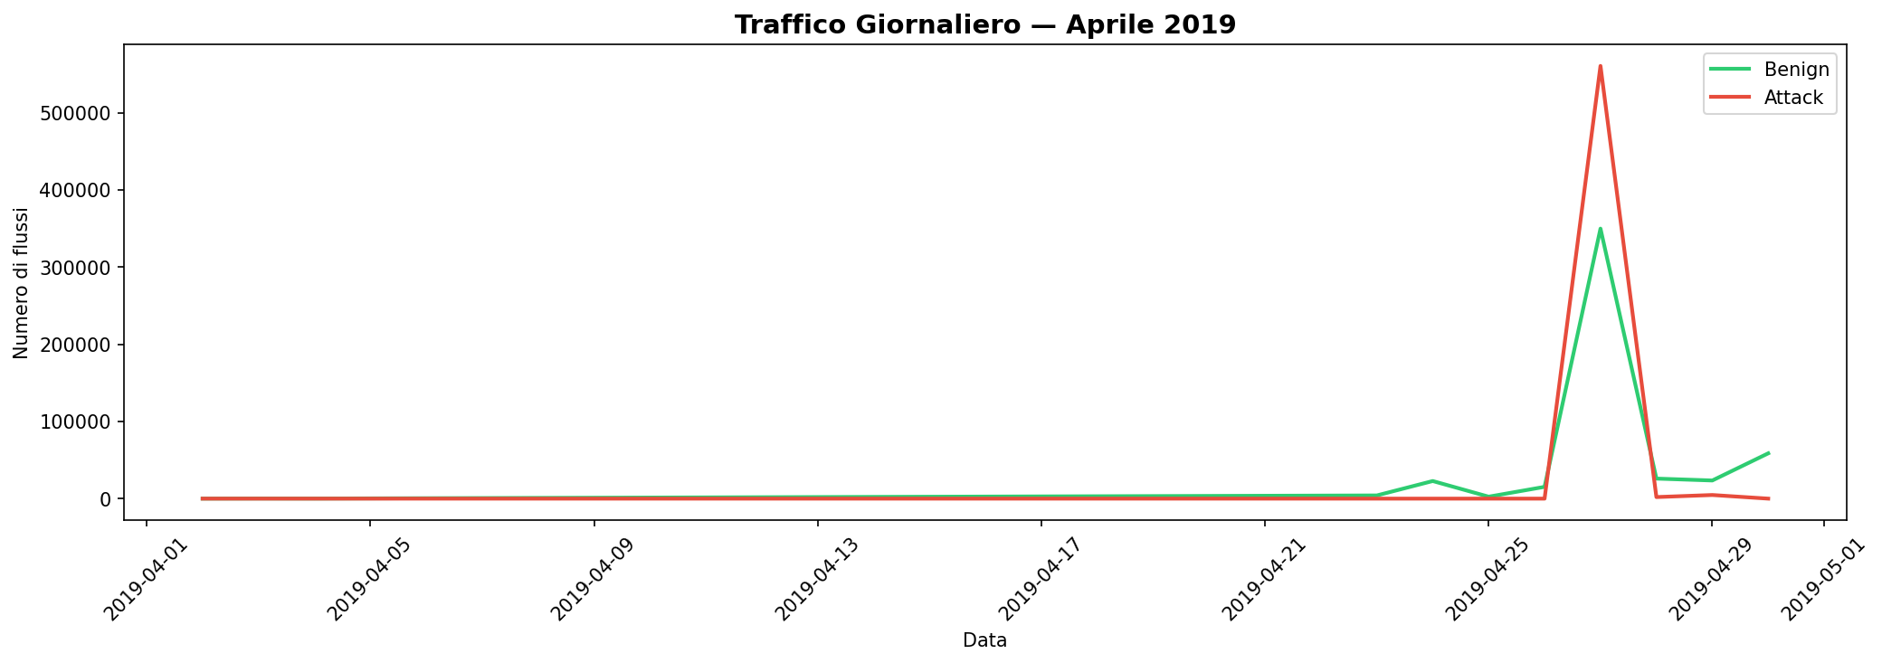
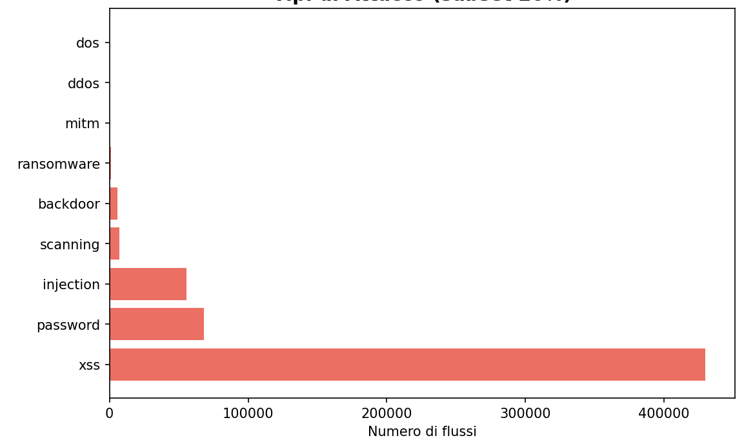
CHAPTER 4 · EXPLORATORY DATA ANALYSIS
Attacks Distribution & Temporal Analysis
CLASS DISTRIBUTION
DAILY TRAFFIC – April 2019
XSS dominates the attacks (~75%), followed by password cracking and injection.
Traffic is nearly flat for the first ~23 days, then explodes in the final 4–5 days: the attack window.
Context-Aware IoT Anomaly Detection
10
Smart Environments

Slide 11
CHAPTER 4 · A HUB-CENTRIC NETWORK
Network Topology
67,124
1,094
TCP
unique source IPs
unique destination IPs
dominant protocol
(≈ 77% of flows)
Strongly asymmetric, hub-centric structure
Far more source IPs than destinations: many devices talk to a handful of servers.
A few high-degree nodes (hubs) concentrate most of the traffic.
This topology is exactly what makes the hub-attack pattern (next slides) so striking.
Smart Environments
Context-Aware IoT Anomaly Detection
11

Slide 12
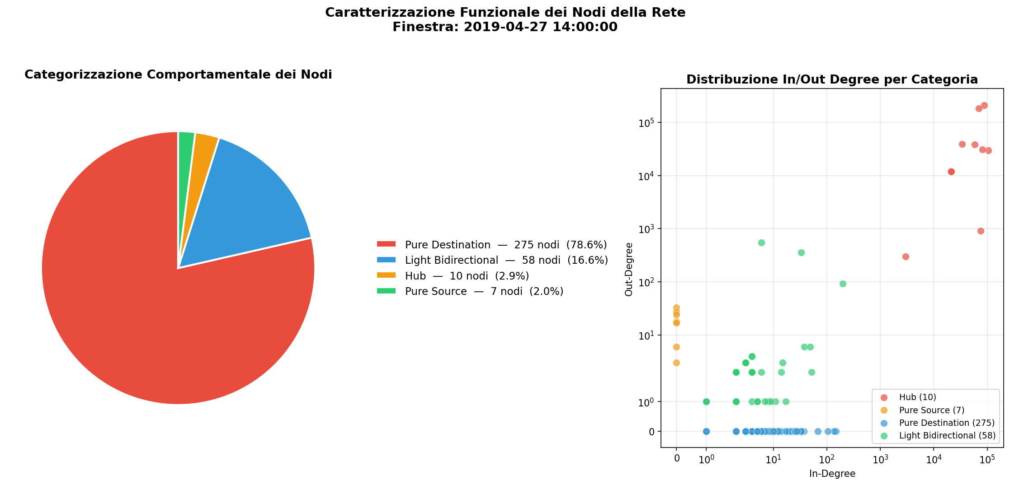
CHAPTER 4 · NETWORK TOPOLOGY
Node Categorization
In/Out Degree Distribution by Node Category
78.6% Pure Destination: nodes that only receive traffic
16.6% Light Bidirectional: nodes that both send and receive
2.9% Hub: high-degree nodes concentrating most traffic
2.0% Pure Source: nodes that only send traffic
Smart Environments
Context-Aware IoT Anomaly Detection
12

Slide 13
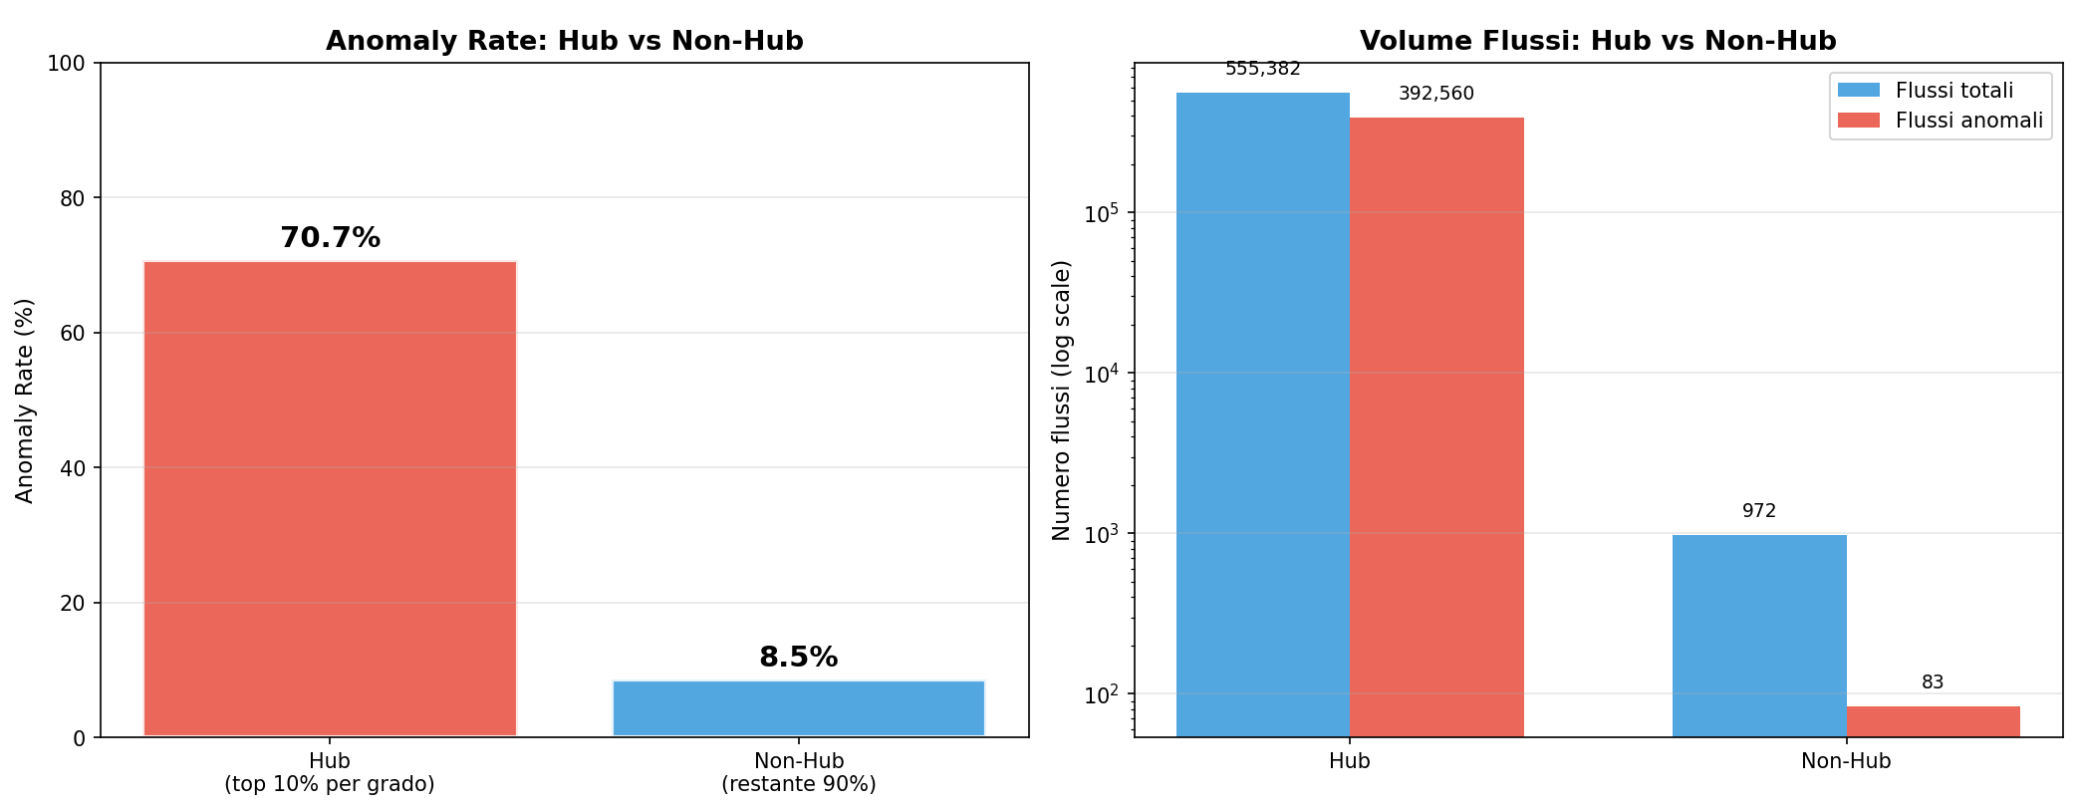
CHAPTER 4 · NETWORK TOPOLOGY
Hub vs Attacks
Hub nodes (top 10% by degree) show an anomaly rate of 70.7% vs 8.5% for non-hubs, 8x more likely to be involved in an attack. Consistent with Barabási-Albert scale-free network theory: high-degree nodes are preferential targets.
Smart Environments
Context-Aware IoT Anomaly Detection
13

Slide 14
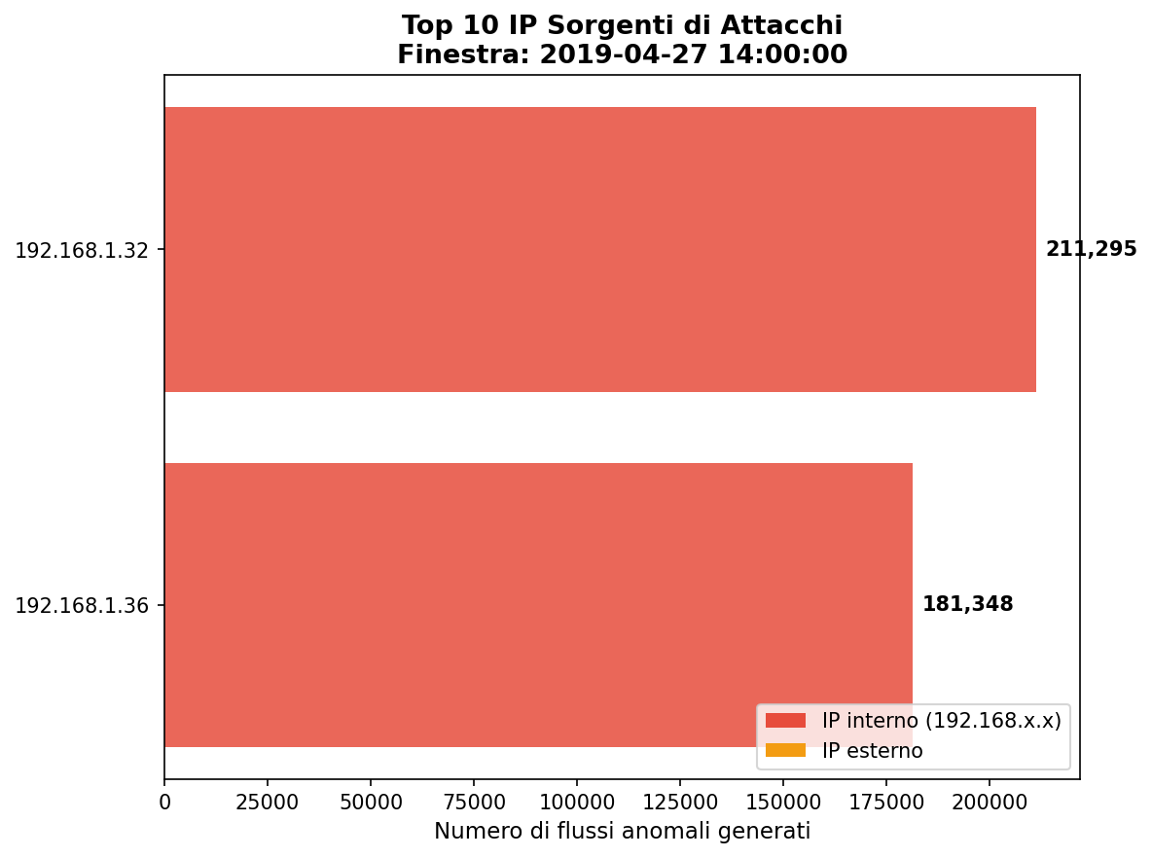
CHAPTER 4 · NETWORK TOPOLOGY
Top Attackers
In this figure all attacks originate from just 2 internal IPs (192.168.1.32 and 192.168.1.36), both hubs, with 100% of their outbound traffic anomalous.
A textbook pattern of compromised IoT devices performing lateral movement.
Smart Environments
Context-Aware IoT Anomaly Detection
14

Slide 15
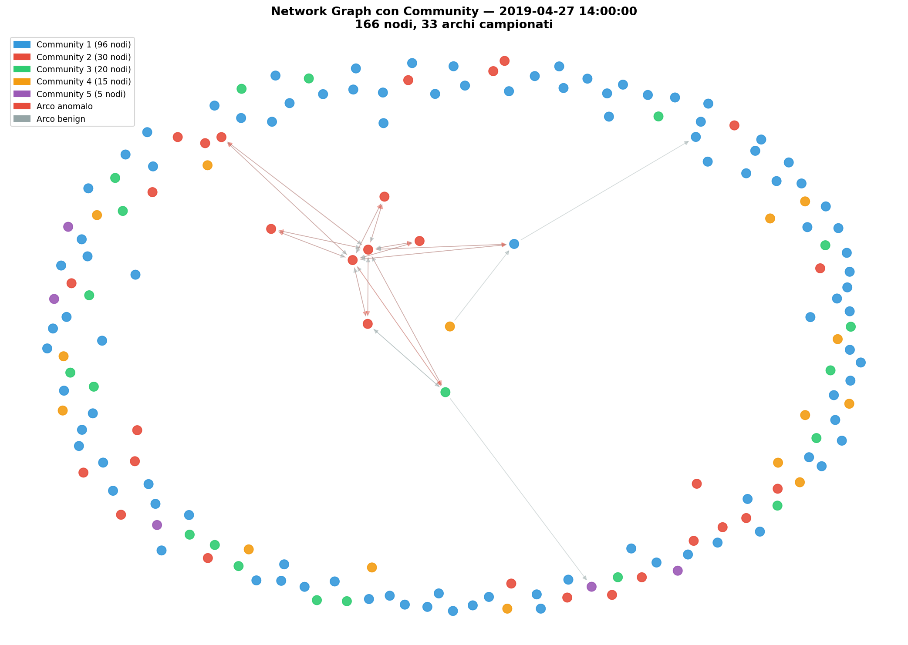
CHAPTER 4 · NETWORK SNAPSHOT
Communities & Anomalous Edges
A single 2h window (27 Apr 2019), colored by LPA community.
Anomalous edges (red) converge on a few central nodes.
Benign edges (grey) spread out to the periphery.
The attack pattern is concentrated, not diffuse so a strong hint of lateral movement.
Smart Environments
Context-Aware IoT Anomaly Detection
15

Slide 16
CHAPTER 4 · LATERAL PROPAGATION
The Attack’s Footprint on Communities
Communities collapse from 23 → 11 during the attack
As the attack unfolds, separate communities merge and the network unifies under the attack traffic.
Anomalous edges stay in the internal-IP plane: the attack spreads from inside, not from outside.
Confirms lateral propagation between compromised internal devices.
▶ Video: Network__evolution_3d.mp4 in the next slide.
Smart Environments
Context-Aware IoT Anomaly Detection
16

Slide 17
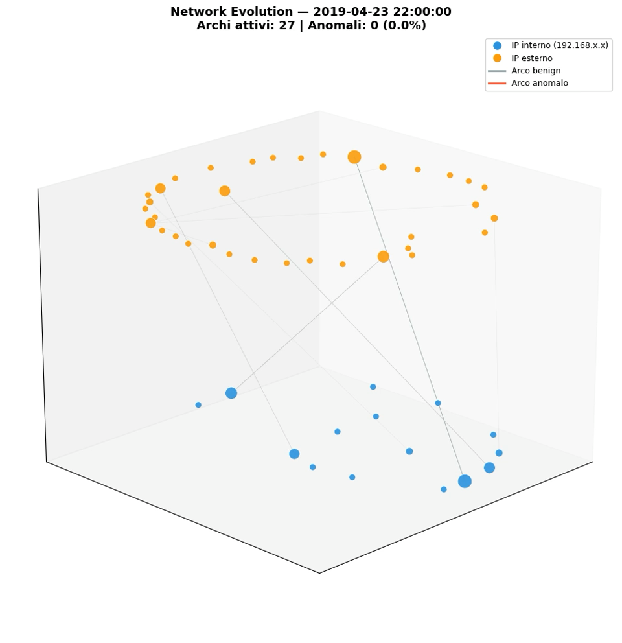
17

Slide 18
CHAPTER 5 · RESULTS (10 EPOCHS)
Comparative Results
AUC
Precision
Recall
F1
Accuracy
A · network
0.999
0.996
0.986
0.991
0.990
B · network + context
0.986
0.979
0.401
0.569
0.648
C · network + knowledge
0.999
0.999
0.982
0.991
0.989
D · all three
0.965
0.986
0.409
0.578
0.654
Key finding: A and C reach ~99% across the board; B and D crash on Recall (~0.40), so they miss most attacks.
Smart Environments
Context-Aware IoT Anomaly Detection
18

Slide 19
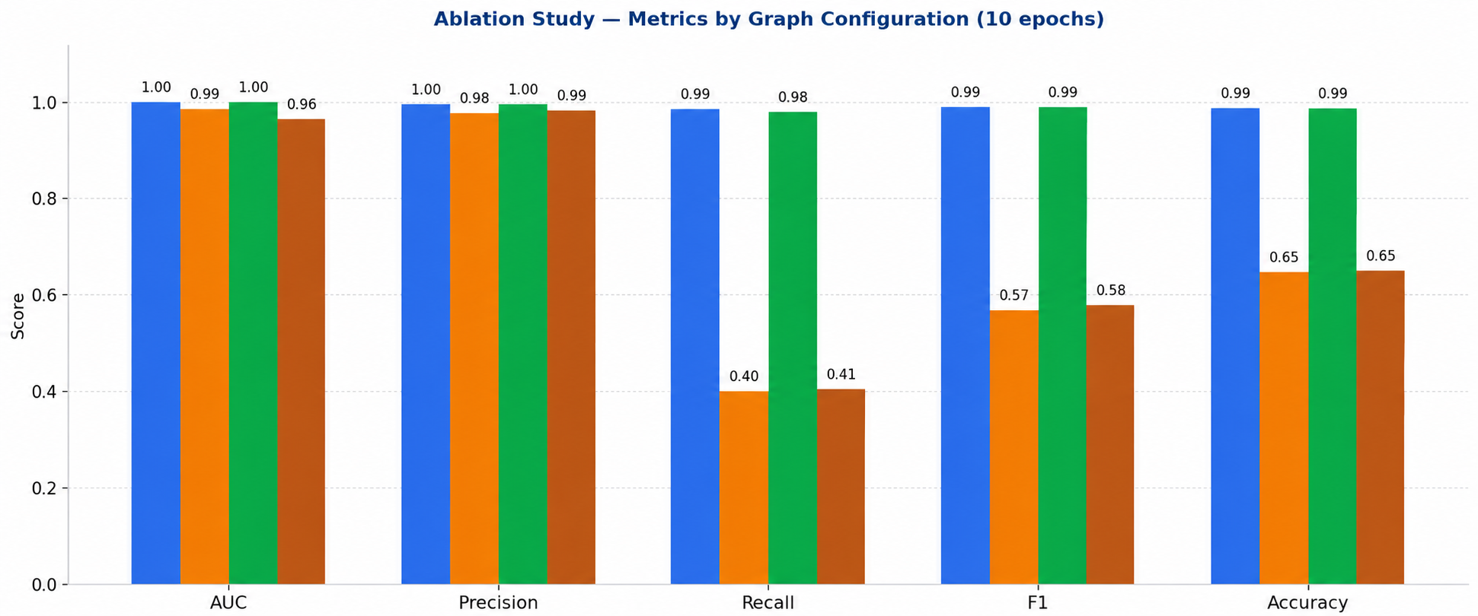
CHAPTER 5 · TWO CLEAR GROUPS
Comparative Visualization
Configuration A
Configuration B
Configuration C
Configuration D
Smart Environments
Context-Aware IoT Anomaly Detection
19

Slide 20
CHAPTER 5 · INTERPRETATION
What the Results Mean
Why A & C win
Why B & D struggle
Communication features alone (A) already separate benign from attack traffic very well.
Knowledge features (C) (TCP flags, segment sizes) add complementary, discriminative signal.
Both keep high Recall: they catch the attacks.
Adding context edges (timestamps, IAT) seems to inject noise that blurs the decision boundary.
Recall collapses to ~0.40 so they keep precision but miss more than half the attacks.
More edge types ≠ better: structure matters more than quantity.
Smart Environments
Context-Aware IoT Anomaly Detection
20

Slide 21
CHAPTER 6 · THE DASHBOARD
Interactive Analysis Dashboard
Architecture
Graph visualizer with edges colored by confusion matrix (TP green, FP orange, FN purple, TN grey)
Real-time metrics panel + “Zoom Anomaly” button
Ablation study comparator with grouped bar chart and raw data table
Innovation
get_ever_active_nodes function for dense node mapping
Per-configuration prediction files (preds_[CONFIG].csv)
Edge-level labeled graphs for post-hoc analysis
▶ Demo: video on the next slide.
Smart Environments
Context-Aware IoT Anomaly Detection
21

Slide 22
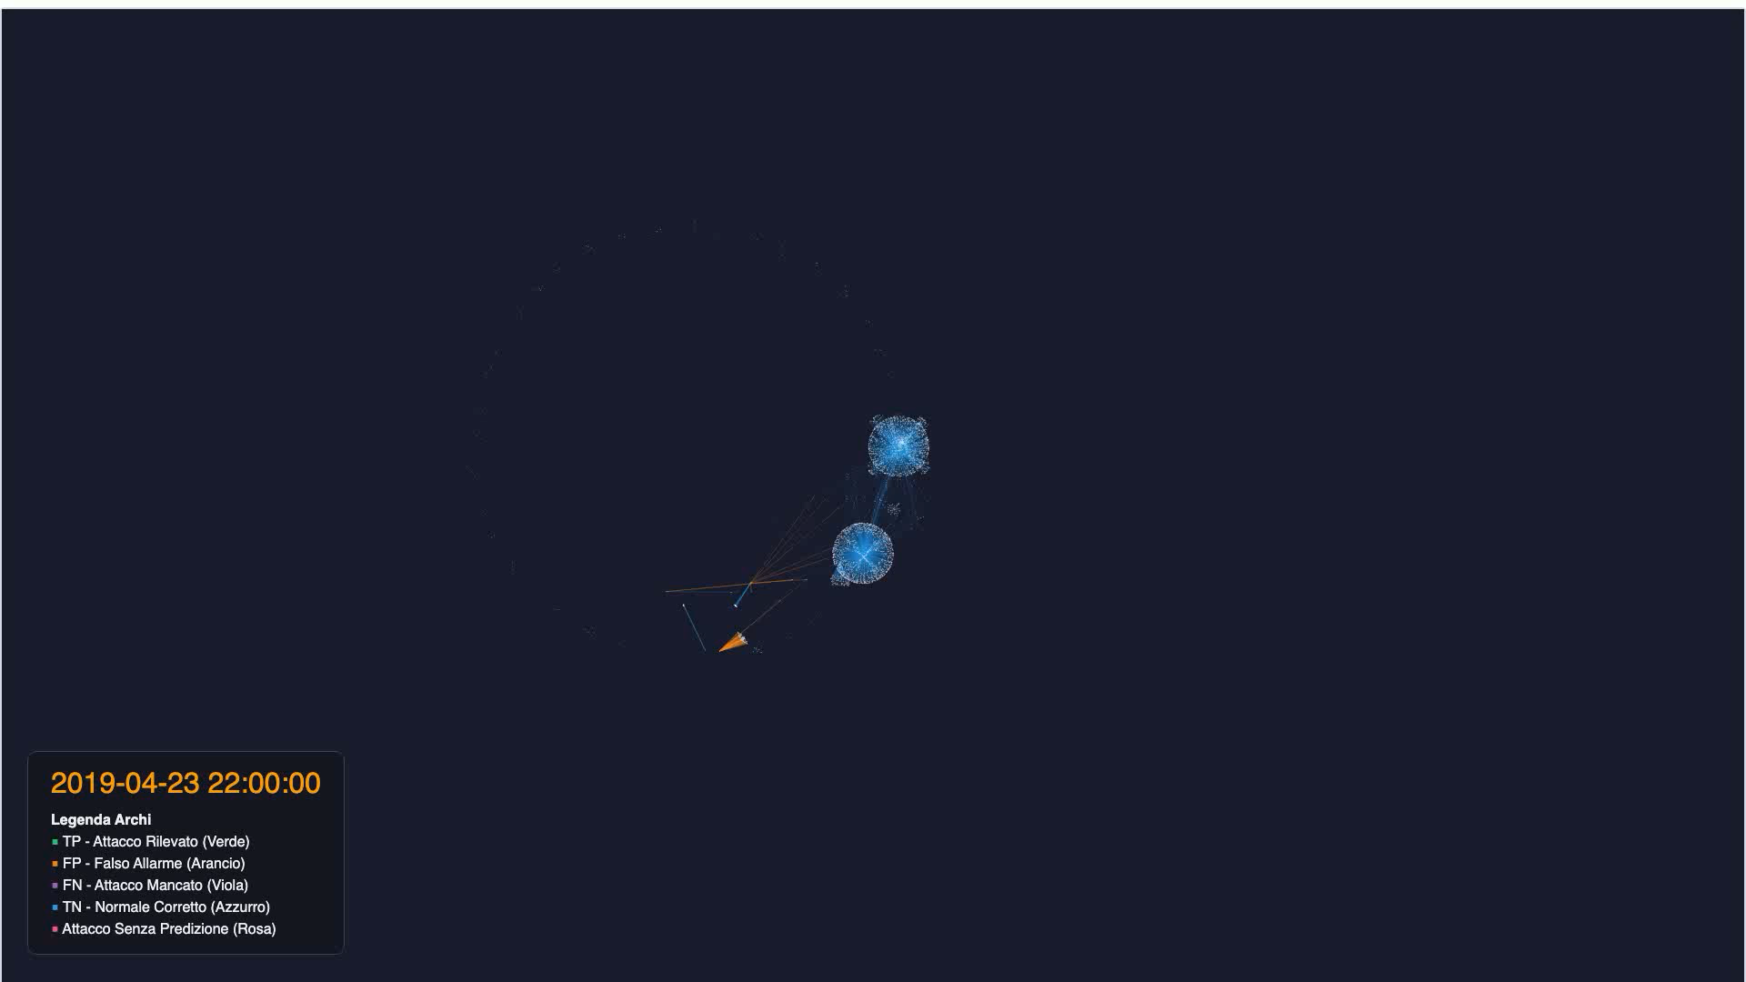

Slide 23
CHAPTER 6 · OUR THREE CONTRIBUTIONS
Conclusions
1
2
3
Graph construction matters
Attacks target the hubs
Lateral propagation
The choice of edge types drives performance more than the model itself.
Anomalies concentrate on high-degree nodes; consistent with scale-free network theory.
Communities collapse as the attack spreads between compromised internal devices.
Surprising takeaway: communication features alone are already competitive. With more resources, B/D might converge but here, simpler graphs win.
Smart Environments
Context-Aware IoT Anomaly Detection
23

Slide 24
CHAPTER 6 · HONEST CAVEATS
Limitations
Training budget
10 epochs vs 70 in the paper; only a 20% subset of the data.
Reliability
Results are seed-dependent; k-fold cross-validation was computationally infeasible.
Methodology
Stratified + temporal split is necessary but debatable for time-series.
Algorithmic
LPA is non-deterministic; community quality varies run to run.
Generalization
Evaluated on a single dataset (CIC-ToN-IoT) only.
Smart Environments
Context-Aware IoT Anomaly Detection
24

Slide 25
FUTURE WORK
Low-Cost Graph
Contraction Techniques
Four ideas we would implement in the future.
Smart Environments
Context-Aware IoT Anomaly Detection
25

Slide 26
FUTURE WORK · CONTRACTION TECHNIQUES
Four Future Improvements
Topological Contraction
Merge identical devices into super-nodes to shrink the graph and make anomalies more visible.
Edge Sparsification
Drop low-volume edges to reduce noise and strengthen LPA community detection.
Feature-Space Contraction (PCA)
Compress node/edge features into 3–5 components to speed up the GNN and remove noise.
Dynamic Temporal Windows
Trigger new graph snapshots only on significant network changes, saving compute cycles.
Smart Environments
Context-Aware IoT Anomaly Detection
26

Slide 27
WHERE THIS PROJECT COULD GO NEXT
Future Work: Beyond Contraction
Full training
50–70 epochs on adequate hardware, with k-fold cross-validation.
Generalization
Evaluate on CIC-IDS2017 and other IoT datasets.
Dashboard
Evolve the analysis tool toward production real-time monitoring.
Community detection
Integrate Louvain offline alongside real-time LPA for more stable communities.
Efficiency: one unified preprocessing layer
Combine the four contraction techniques into one lightweight preprocessing layer.
Smart Environments
Context-Aware IoT Anomaly Detection
27

Slide 28
Thank You
Questions & Discussion
Antonio Pagnotta · Francesco La Piana · Paolo Cencia
Paper: https://www.sciencedirect.com/science/article/abs/pii/S0140366426000046
Repo: https://github.com/francescolp23/iot-graph-ablation-project
Code: https://github.com/AntonioPagnotta/iot-graph-construction-ablation

